Slide 1
Esports Community App in Pakistan

Slide 2
Members
Abdul Jalil Mian – BSCS13062
Mariyah Kaleem – BSCS13065
Shehryar Raza – BSCS13020

Slide 3
Problem Domain
Gaming Community of Pakistan
Esports on the rise
No forums or community app for general E-sports

Slide 4
Initial POV
A community forum for gamers in Pakistan
Smartphone app that notifies of nearby events and meetups

Slide 5
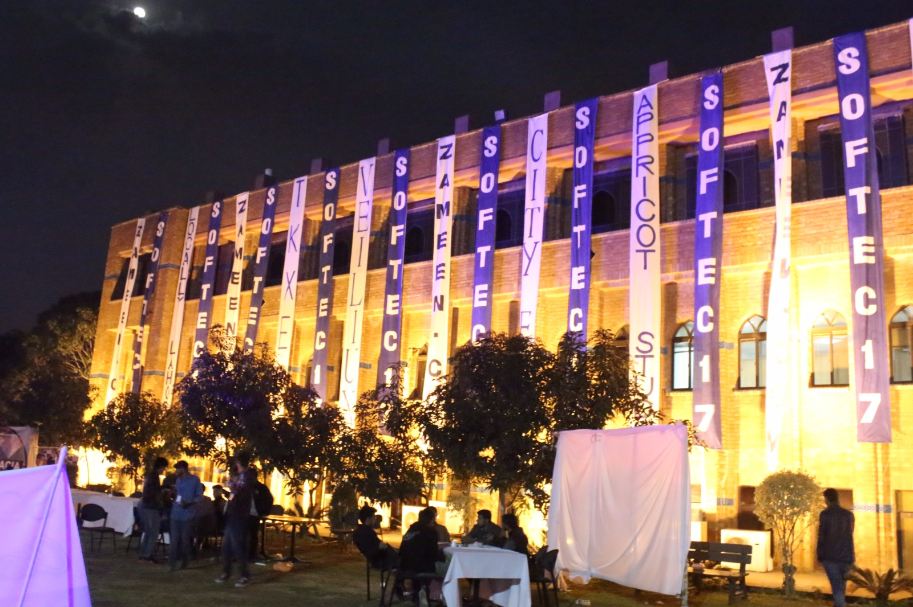
Who did we interview?
Gamers and event organizers
SOFTEC one of the largest gaming events of Pakistan

Slide 6
Additional Need findings
See | Feel
The players saw and visualized our idea in an entirely different way since this is the first time in Pakistan that the development of esports industry is taking place. | The gamers felt that the introduction of such an app to the market will revolutionized the current situation of esports in Pakistan.
Do | Think
The gamers told us that they do get information through Facebook about the gaming events in Pakistan. | The participants in the gaming event at SOFTEC thought that there is a definite need for an automated system/app which notifies the gamers about the nearby events in Pakistan.

Slide 7
POV - 1
We met the captain of Team Envy Dota 2. We were surprised to see that he has already seen an app in US, similar to what we want to develop. However, it was a multinational company and was funded with a lot of resources. It would be game changing if we could try to come up with a better solutions than the rest of the apps available for esports gaming.

Slide 8
POV -2
We interviewed the winning captain of SOFTEC Dota 2 and asked him about the views of esports events in Pakistan and a need for a community forum. We were surprised to see his remarks on the esports gaming app as he told us that due to his contacts with different gaming communities, he is already aware of the events nearby him. It would game changing if we could bring those event coordinators and gamers on our platform and ask them to share their events on our platform.

Slide 9
POV - 3
We interviewed the event in-charge of SOFTEC gaming competition. We were amazed to know that for SOFTEC, some gamers and participants schedule their journey and trainings at most one week prior to the start of the main event. It would be game changing if we could gather the data and personal interests of each individual about gaming at major events and then set the organizer to notify in time.

Slide 10
HMW for POV - 1
HMW develop a better or similar app existing in international market?
HMW bring people to our platform?
HMW secure the resources that we need?

Slide 11
HMW for POV - 2
HMW find event coordinators and gaming companies?
HMW convince different event coordinators to publish on our app?
HMW provide a secure database for all the event details to sync with?

Slide 12
HMW for POV - 3
HMW record participants’ usage information from the app?
HMW develop an automated system to handle the in-time notifications?
HMW add event details from organizers not using our app?

Slide 13
Top HMW - 1
HMW develop a better or similar app existing in international market?
(from POV - 1)
Solutions
Conduct surveys
Collect anonymous data
Add themes and ability to change the UI
Design a UI that fits the game title

Slide 14
Top HMW - 2
HMW find event coordinators and gaming companies?
(from POV - 2)
Solutions
Search for popular gaming events
Look for people interested in organizing tournaments
Bring together small scale LAN gamers for meetups

Slide 15
Top HMW - 3
HMW provide a secure database for all the event details to sync with?
(from POV -2)
Solutions
Give secure accessibility
Add encryption
Contact the organizer for confirmations

Slide 16
Experience Prototypes
Gathered ideas on paper
Made rough prototypes on moqups.com
Tested prototypes by showing mock ups to audience on a smart phone

Slide 17
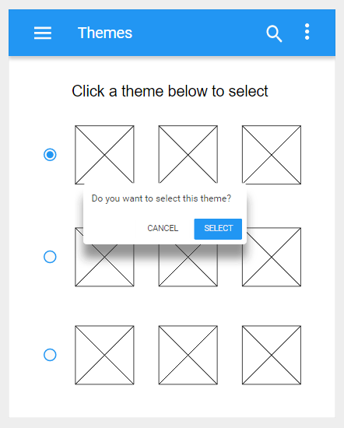
Prototype 1
We let the user control the colors and font of the app by offering them various theme options
Assumption
Users like control and customizability
Testing
People liked the idea of themes
Few people gave ok-ish feedback

Slide 18
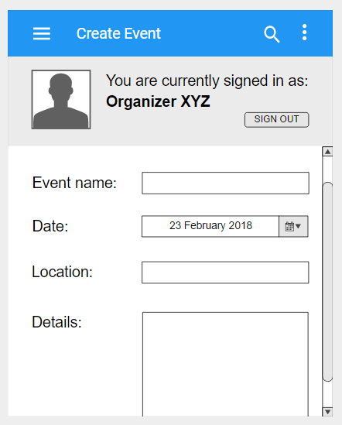
Prototype 2
We let the organizers make their accounts and create events and meetups on their own
Assumption
More control to organizers means less miscommunications
Testing
People liked anyone can create their events
Some people were concerned about confirmations and authenticity

Slide 19
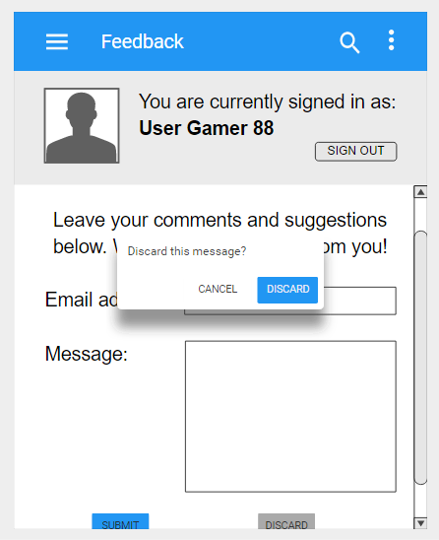
Prototype 3
We let users leave helpful feedback directly from the app
Assumption
Users should have the option to leave comments and offer suggestions
Testing
“Not necessary but definitely helpful”

Slide 20
QUESTIONS?

